Slide 1
CyberPDX
Programming Day 4

Slide 2
Merging programming with cryptography and security
Two parts
Building a Vigenere encoder
Brute-forcing web-based authentication

Slide 3
Vigenere
We want to be able to recreate the vigenere table.
Can we do this easily?
With just one string of letters?

Slide 4
Vigenere (encoding)
Encode “bit”
Key=“fox”

Slide 5
Vigenere (encoding)
Encode “bit”
Key=“fox”
What are the indices of these letters in the string
“abcdefghijklmnopqrstuvwxyz”
b = 1 (remember we start with 0)
f = 5
g = 6
1 + 5 = 6

Slide 6
Vigenere (encoding)
Encode “bit”
Key=“fox”
What are the indices of these letters in the string
“abcdefghijklmnopqrstuvwxyz”
i = 8 (remember we start with 0)
o = 14
w = 22
8 + 14 = 22

Slide 7
Vigenere (encoding)
Encode “bit”
Key=“fox”
What are the indices of these letters in the string
“abcdefghijklmnopqrstuvwxyz”
t = 19 (remember we start with 0)
x = 23
q = 16
19 + 23 = 16 ?!?
Why?

Slide 8
Vigenere (encoding)
What are the indices of these letters in the string
“abcdefghijklmnopqrstuvwxyz”
t = 19 (remember we start with 0)
x = 23
q = 16
19 + 23 = 16 ?!?
What if the number is greater than 25?
Wrap around to beginning
% – Modulo Operator
1 % 26 = 1
2 % 26 = 2
26 % 26 = 0
27 % 26 = 1
(19 + 23) % 26 = (42) % 26 = 16

Slide 9
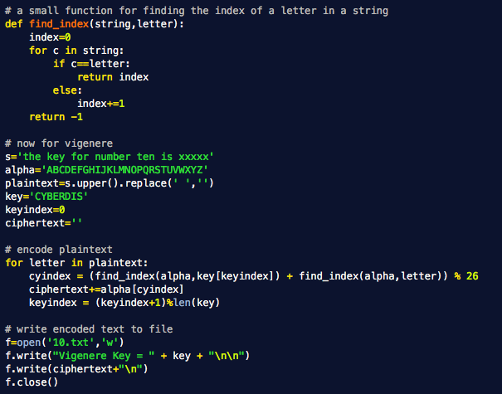
vigenere.py
This math should be familiar now.

Slide 10
Web programming with Python

Slide 11


What happens when you go to a webpage?
Request
Internet
Hostname
Pathname
sheldonbrown.com
Your Web
Browser
When you enter a URL into your web browser you make a request over the Internet
Your request makes its way to the host specified by the hostname in the URL
Your Computer

Slide 12
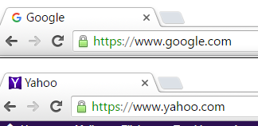


A word about domain separation
Request
Internet
Hostnames identify domains
Domains physically separated at different locations

Slide 13
Usually…
import socket
print(socket.gethostbyname('cyberd.oregonctf.org'))
print(socket.gethostbyname('malware.oregonctf.org'))
print(socket.gethostbyname('pucca.cs.pdx.edu'))
Domain separation must be performed on the physical machine itself!

Slide 14
What happens when you go to a webpage? (cont)
The web server sends the webpage and related resources back to your computer.
Web page is (at minimum) an HTML file with several referenced objects.
Your Web
Browser
Response
Your Computer
Web Server Host

Slide 15
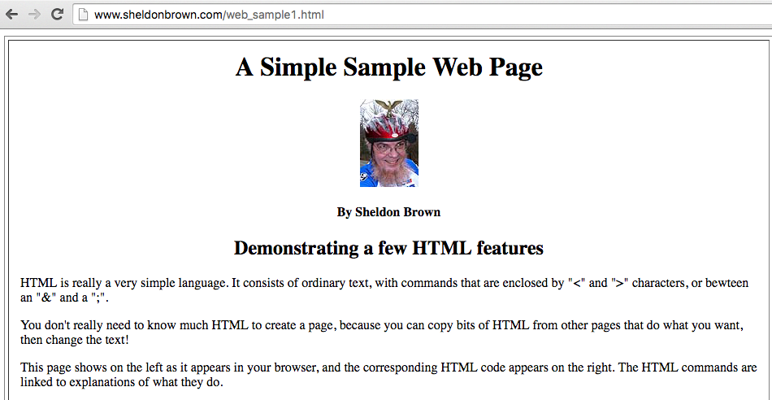
Web Overview – HTML
What is HTML?
A markup language used to describe a web page
<html>
<head>
</head>
<body>
<h1>My first header</h1>
<p>My first paragraph</p>
<!– This is a comment -->
</body>
</html>
Rendered by
your browser

Slide 16
Security is essential
Requires web sites to authenticate us (and vice versa)
Authentication must be layered
Multiple mechanisms for identifying users

Slide 17
Exercise: Examples of authentication layering
What you know. Who you are. What you have. Where you are.

Slide 18
Exploring Basic Authentication in Python
But first…

Slide 19
How can we write a program that interacts with a website?
In Python we will use a library called Requests (HTTP for humans)
Allows us to get a webpage and print it to the screen
import requests
r=requests.get(‘http://chi-ni.com/’)
print(r.text)
Where can we go to find out more about what is in requests?
http://docs.python-requests.org/en/master/

Slide 20
How might I restrict access to authenticated users?
How about a username and password?
Web’s initial method: Basic Authentication
Prompt user within browser pop-up
Sends username and password in the clear
Requires another layer if you use it!
e.g. Safe to use with https
(unless Tim is in your network)

Slide 21
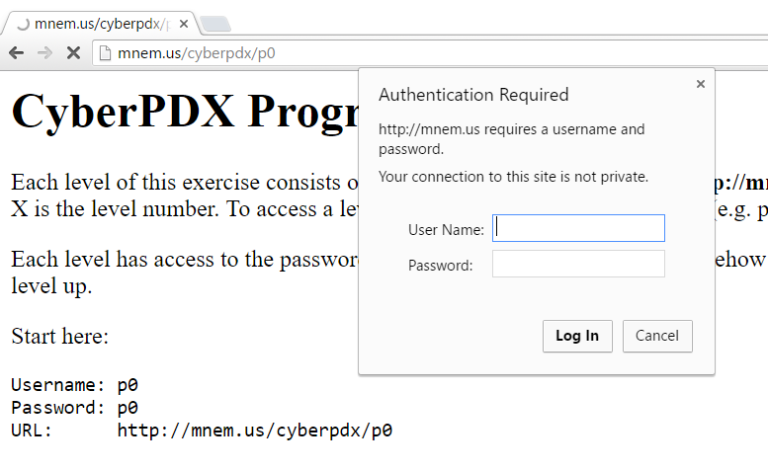
Let’s give it a shot

Slide 22
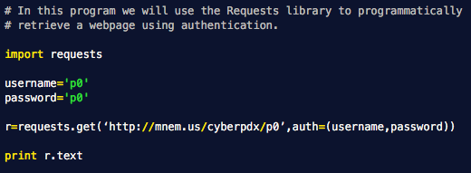
Now, let’s do it in requests

Slide 23
How about p2?
http://mnem.us/cyberpdx/p
Username = p2
Password = ?
Try a brute force attack

Slide 24
Let’s give it a shot

Slide 25
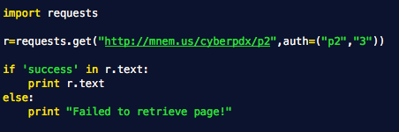
Now let’s do it in requests

Slide 26
Can we brute-force the password with a program?

Slide 27
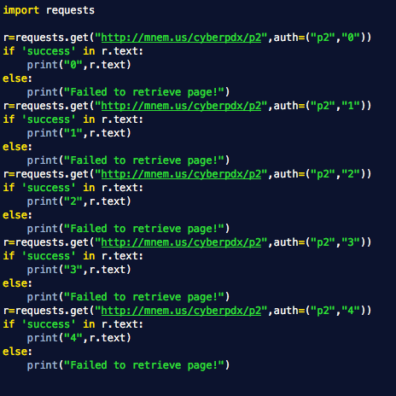
Brute_web.py

Slide 28
Exercise
Navigate to http://mnem.us/cyberpdx/p3
Write a function to figure out the password for P3
You will need one for loop, one if statement
You will also need the “str” function to convert the integer to an ASCII string
Say what?

Slide 29
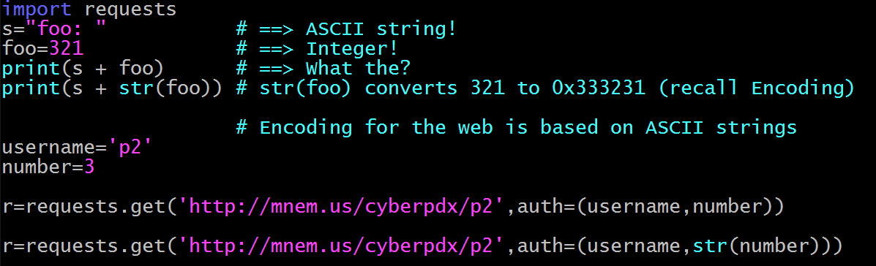
Recall encoding
321
0x333231
321 in decimal
321 in ASCII or “321”

Slide 30
Which line is preferable?

Slide 31
Exercise
Navigate to http://mnem.us/cyberpdx/p3
Write a function to figure out the password for P3
You will need one for loop, one if statement
You will also need the “str” function to convert the integer to an ASCII string

